Slide 1
Chapter 11 Automation of Administration Work

Slide 2
Objectives
Able to describe necessity of automation of administration operation
Able to use commands that automatic administration work

Slide 3
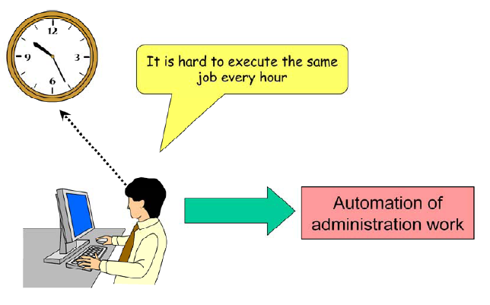
Necessity of administration work automation
Notes:
The cron function is a function to execute the command at the specified time. This enables the automation of the system administration work such as periodic backup work and unnecessary file deletion, etc.
The human being may occasionally fail due to forgetfulness, but you can surely execute it if you use the ‘cron’ function. Because the system administration work includes a lot of contents repeatedly executed, the use of the ‘cron’ function enables a great reduction of the work.

Slide 4
Function to automate administration work
Notes:
As for the commands which uses the ‘cron’ function, there are ‘cron’ and ‘at’. ‘cron’ executes the , process periodically at the specified time, and ‘at’ is used to execute the process only once at specified time.
crond is a daemon process, and it starts the command stored in spool file at specified time.

Slide 5
cron – configuration file of ‘cron’

Slide 6
cron files
cron executes tasks by referring to the following files and directory's subordinate files.
/etc/crontab : Configuration file of ‘cron’ main
/etc/cron.hourly : Directory storing the script that starts at one minute per hour
/etc/cron.daily : Directory storing the script that starts at 04:02 every day
/etc/cron.weekly : Directory storing the script that starts at 04:22 on Sunday every week
/etc/cron.monthly : Directory storing the script that starts at 04:42 on the first every month
/var/spool/cron : Directory storing the ‘cron’ configuration file of each user

Slide 7
crontab
The command to edit the crontab file (spool file) prepared for each user is the crontab command. The system administrator can manage the ‘crontab’ file for the general user by specifying the user.
Options:
-e : Creation and modification of the ‘crontab’ file
-r : Remove the ‘crontab’ file
-l : Display the ‘crontab’ file
crontab [option] [user_name]

Slide 8
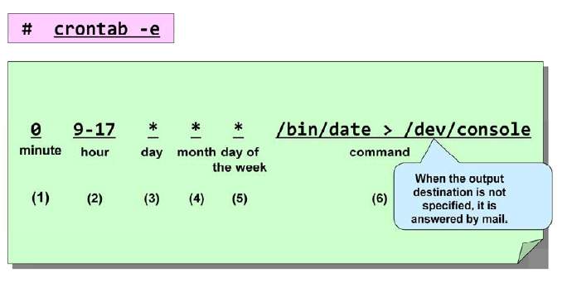
Registration of ‘cron’
Notes:
We are going to describe how to register to the ‘crontab’ file
To register the ‘contab’ file, execute ‘crontab’ command using ‘e’ option. Then, the editor starts, so register the setting of ‘crontab’ on the editor. When the system is starting in the CUI mode, ‘vi’ starts as standard. You can specify a editor by the environment variable EDITOR.

Slide 9
Fields in the ‘crontab’ file
Notes:
There are 6 fields in the ‘crontab’ file to register.

Slide 10
Description methods
(1) * : The asterisk specifies all possible values for a field.
(2) numeric 1 - numeric 2 : The hyphen specifies all numeric that are included in the range of numeric 1 and numeric 2.
(3) value1,value2 : The comma specifies some numerics in the same field.
(4) range/integer : The slash specifies the step value of the values in the range. The combination with * is also possible.

Slide 11
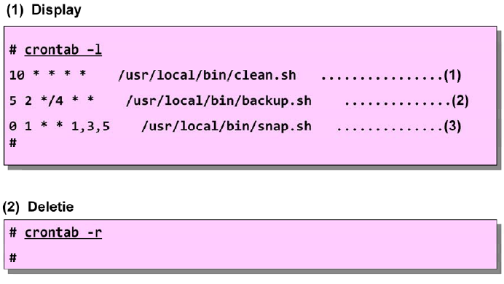
Display and Delete of ‘cron’
Notes:
We describe how to display or delete the 'crontab' file.
(1) To display the contents of the ‘crontab’ file, execute the ‘crontab’ command by using ‘-l’ option.
The setting of the above example is the following.
(a) Execute the shell script for the file arrangement at ten minutes per hour.
(b) Execute the shell script for the backup at 02:05 every 4 days.
(c) Execute the shell that obtains the system status at one o'clock of every Monday, Wednesday and Friday.
(2) To delete the contents of the ‘crontab’ file, use the “-r” option. As a result, the user's ‘crontab’ file is deleted.
When you want to delete only a part among the setting contents of ‘crontab’, edit by using the ‘-e’ option of
the ‘crontab’ command.

Slide 12
Limitation of ‘cron’ user
Notes:
The system administrator can limit the user who can use the ‘cron’ function.
To limit the users of the ‘crontab’ command, create 'cron.allow' file or ‘cron.deny’ file. To the ‘cron.allow’ file, register the name of the user which the use of ‘crontab’ is permitted. To the ‘cron.deny’ file, register the name of the user which the use of ‘crontab’ is not permitted.
When a user issues the ‘crontab’ command, the ‘crontab’ command checks the ‘cron.allow’ file, and examines whether the user is registered. If the ‘cron.allow’ file exists and the user is not registered, the user cannot use ‘crontab’. If the ‘cron.allow’ file doesn't exist, the ‘cron.deny’ file is checked next. If the user is registered in this file, the user cannot use the ‘crontab’ command.

Slide 13
‘at’ command
Notes:
The at command is a command to execute a command at the specified time.

Slide 14
at (cont.)
(1) Use the ‘at’ command to register ‘at’.
Option:
-q : Specification of queue
-f : Read the command to be executed from not the command line but the file.
-m : When the job has completed, send a mail to the user to inform it.
at [-q queue] [-f file] [ -m] TIME

Slide 15
at (cont.)
(2) Use the ‘atq’ command to verify the contents registered by the ‘at’ command.
(3) Use the ‘atrm’ command to cancel the contents registered by the at command.
atq [-q queue] [-v]
atrm job [job...]

